Slide 1
Learning Big Data
Aditya Konda
Big Data Engineer

Slide 2

HBase: Overview
HBase is a distributed column-oriented data store built on top of HDFS
HBase is an Apache open source project whose goal is to provide storage for the Hadoop Distributed Computing
Data is logically organized into tables, rows and columns

Slide 3
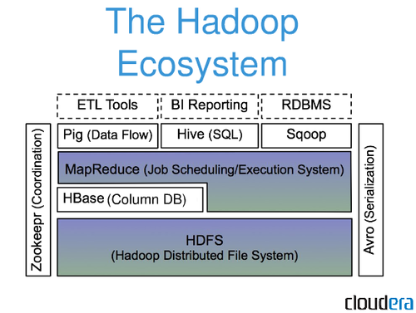
HBase: Part of Hadoop’s Ecosystem
HBase is built on top of HDFS
HBase files are internally stored in HDFS

Slide 4
HBase vs. HDFS
Both are distributed systems that scale to hundreds or thousands of nodes
HDFS is good for batch processing (scans over big files)
Not good for record lookup
Not good for incremental addition of small batches
Not good for updates

Slide 5
HBase vs HDFS
HBase is designed to efficiently address the above points
Fast record lookup
Support for record-level insertion
Support for updates (not in place)
HBase updates are done by creating new versions of values

Slide 6
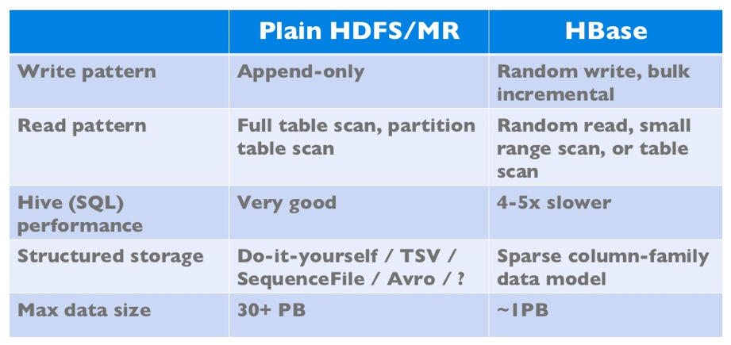
HBase vs HDFS
If application has neither random reads or writes ➔ Stick to HDFS

Slide 7
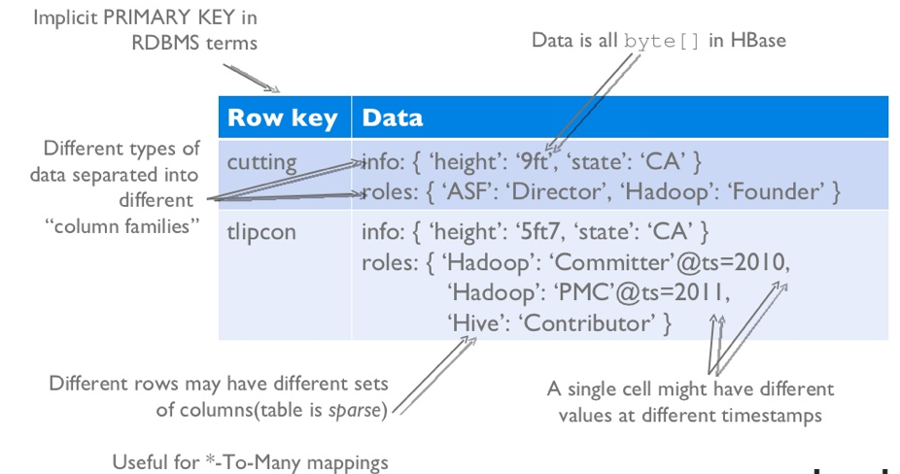
HBase Logical View

Slide 8
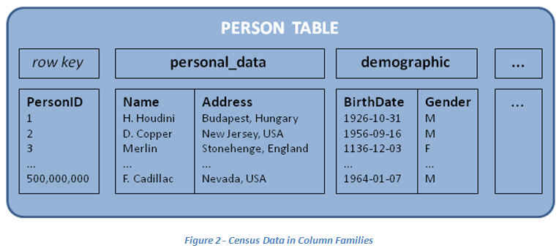
HBase: Keys and Column Families
Each record is divided into Column Families
Each row has a Key
Each column family consists of one or more Columns

Slide 9
HBase Architecture

Slide 10
Three Major Components
The Hbase Master
One master
The Hbase Region Server
Many region servers
The HBase client

Slide 11
HBase Components
Region
A subset of a table’s rows, like horizontal range partitioning
Automatically done
Region Server (many slaves)
Manages data regions
Serves data for reads and writes (using a log)
Master
Responsible for coordinating the slaves
Assigns regions, detects failures
Admin functions

Slide 12
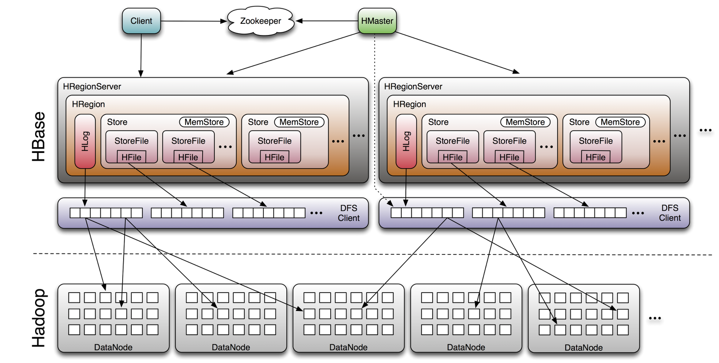
Architecture

Slide 13
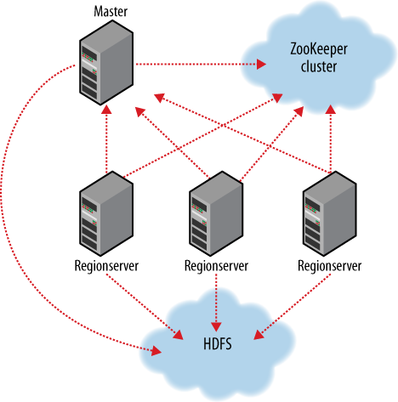
ZooKeeper
HBase depends on ZooKeeper
By default HBase manages the ZooKeeper instance
E.g., starts and stops ZooKeeper
HMaster and HRegionServers register themselves with ZooKeeper

Slide 14
HBase vs HDFS

Slide 15
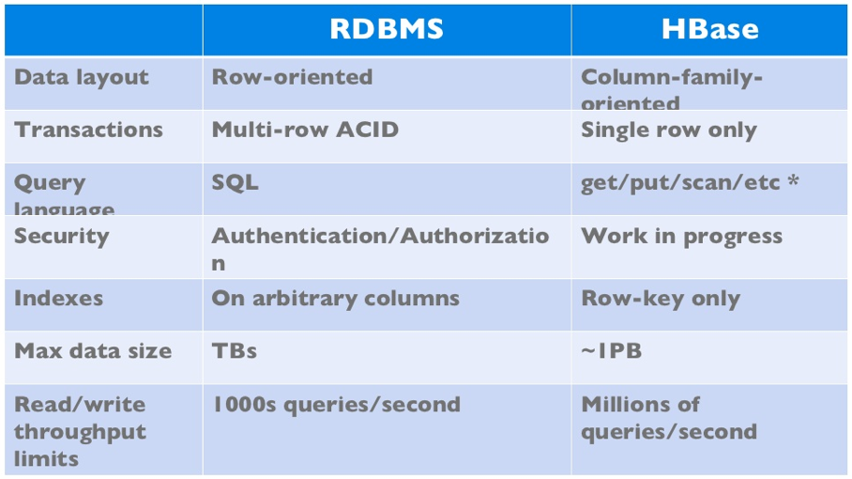
HBase vs RDBMS

Slide 16
When to use HBase
Random write, random read, or both(but not neither)
To do many thousand of operations per second on multiple TB of data
Access patterns are well-know and simple

Slide 17
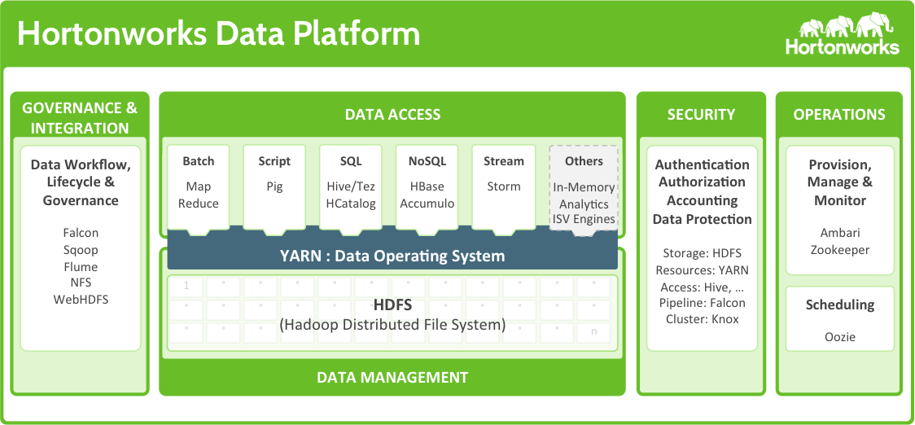
Hortonworks – ecosystem

Slide 18
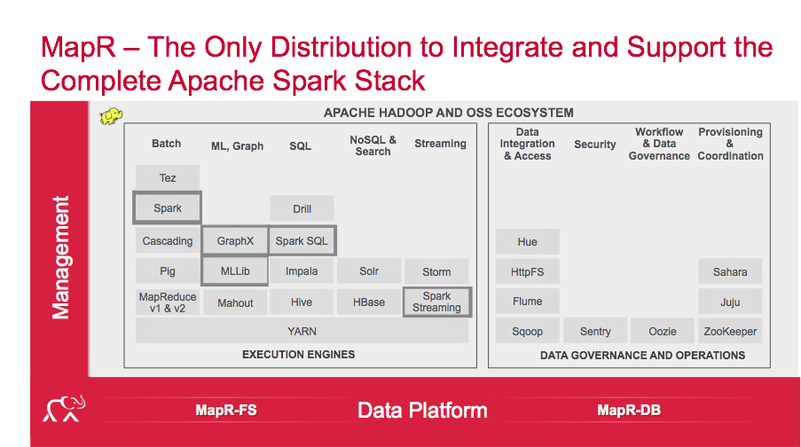
MapR – ecosystem

Slide 19
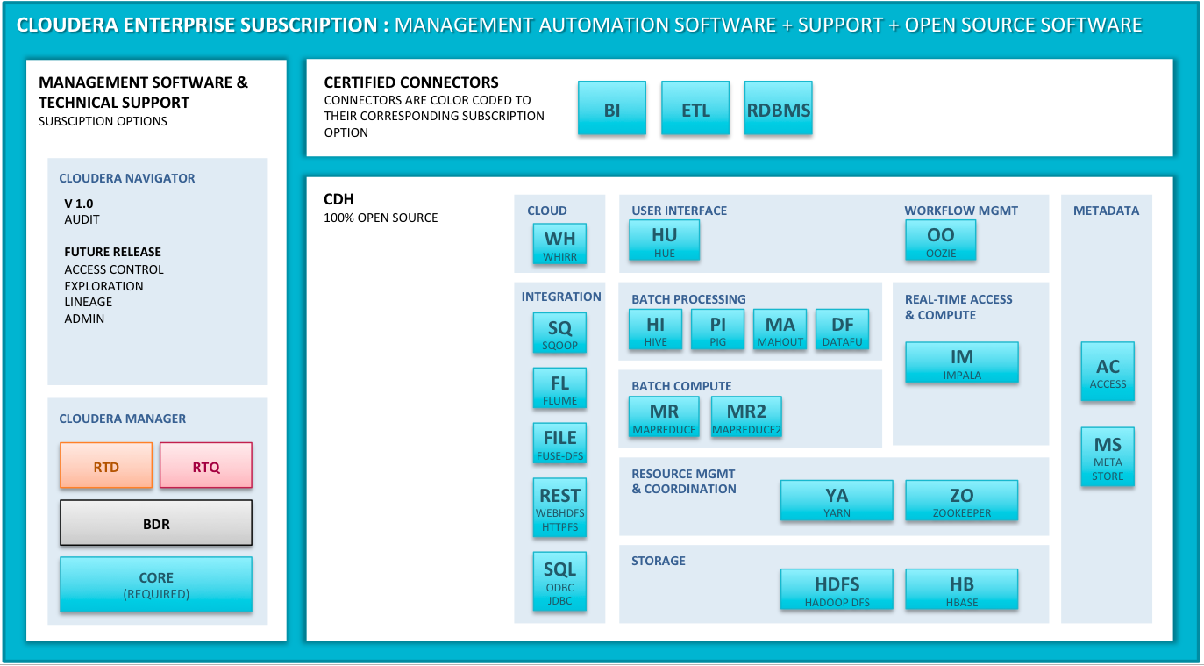
Cloudera – ecosystem

Slide 20


